Slide 1
Software Supply Chain Attack Management using Blockchain
Under the supervision of - Prof. D.K.Yadav
Team leader : Anuj kesarwani 20208022
Member : Harshit chaudhari 20208054
Member : Jitendra kumar 20208060
Member : G.arlapati Tarun 20208047

Slide 2
Introduction
Motivation
Problem Decription
Related Work
Table of content
Technology Used
User Interface and Operation Steps
Conclusion
Future Work
References

Slide 3
Introduction
Software components and services have become the main building blocks for distributed software projects, allowing software engineering to become truly global. With the rise of distributed components and orchestrated software services, developers can now leverage these building blocks to create highly modular and scalable software systems.
Despite the benefits of software components, there are still concerns about trust and security[1]. When evaluating a software component, system integrators treat it as a black box, meaning they have limited visibility into the component's implementation details. This can create uncertainties around the component's trustworthiness, security, and potential vulnerabilities[5].
To address these concerns, we have created a decentralized platform that utilizes blockchain technology and InterPlanetary File System (IPFS) to enable developers to securely upload, share, and reuse software components. With our platform, developers can leverage the benefits of pre-built software components, while also ensuring that they are secure, trustworthy, and free of vulnerabilities.

Slide 4
Motivation
The use of open-source software has become increasingly prevalent in recent years, with many developers relying on pre-built components and libraries to accelerate their development process. While open-source repositories have made it easier for developers to find and use these components, there are concerns about the trustworthiness of the code they contain.
Many mechanisms have been used to create open-source repositories, but they do not always provide sufficient trust in the security of the code. This lack of trust can make it difficult for developers to evaluate the quality of the code and assess the potential risks associated with using it in their projects. To address this challenge, there is a growing need for new technologies that can increase trust in open-source repositories. The advent of blockchain technology and its immutable nature make it the perfect technology for building an open-source repository that enables software developers to upload and share their component's code with complete confidence in their security.

Slide 5
Problem description
Because the components and services are provided to the system without the possibility of a detailed inspection of its internals, global system integrators are walking on edge to approve such building blocks inside the system. Existing trust-assurance methods are either Invasive or Non- invasive. Invasive methods are made for stress testing of components, for the prediction of its inner properties, or for emulating real-time use of them. Some invasive methods treat the component as a "gray box", or "glass box" and even use reverse engineering methods in order to disclose the internal structure and/or the algorithms implemented. This is on the edge in the legal context and gives a lot of ethical questions. Non-Invasive methods are based on certificates and signatures. etc. The component is treated as reliable and trustful of some authority (including big corporations) claims so.
The purpose of this project is to tackle the main issues of the software components and services trust and to present the blockchain-based model of software metadata registration and retrieval to increase the trust for the software composition entities.

Slide 6
Related work
Related and proposed references that discussed how the OSS supply chain can be tracked is, by proposing to create three types of networks: dependency network, code reuse network and knowledge flow network [8].
Another reference has briefly discussed the issue of the trusted software supply chain, where their proposed solution is a blockchain-enabled governance framework for a trusted software supply chain that tries to address the challenges, such as compliance and governance, provenance, security, integrity, etc [5]. This governance framework describes methodology where authors have provided realization of this framework utilizing the TestRPC Ethereum blockchain network.
A similar architecture was proposed by the reference [3], where the solution is intended for improving supply chain quality management, by adopting ‘Blockchain technology’. This blockchain-based supply chain quality management framework has four layers, based on different functions. As a solution that relies on ‘smart contracts’, it is a promising approach and should be followed once the design is applied for a real-world application.

Slide 7
Related work
Related and proposed references that discussed how the OSS supply chain can be tracked is, by Another study on product traceability is referenced in the paper [5], where they have proposed a solution called OriginChain, which employs a geographically distributed private blockchain at the traceability service provider. Another framework for securing the supply chain is proposed in reference [6], where TrustChain design uses a consortium blockchain to track interactions among supply chain participants and to dynamically assign trust and reputation scores based on these interactions.
A research paper from 2018 referred [4], interviewed 18 experts on blockchain disruption in supply chains and industrial applications, concluding that blockchain is not disruptive. Instead, it is a sustaining innovation. An important distinction was made by the referred publisher
[5],where they have kept some information off-chain, i.e.they proposed a combination of blockchain and SupplyChain(Off-chain) coordinated by a Server Blockchain Interface , which receives data for each Server Supplier . SupplyChain challenges were present in the
the referred paper [2], where it was emphasized over the importance of trustworthiness of systems through security, safety, privacy, resilience and reliability.

Slide 8
Technologies Used :
Smart Contract: A smart contract is a self-executing contract that follows rules and regulations when written. In the Open Source Repository project, the smart contract has functions to generate hash, return repository details, and add details to the memory. This ensures a secure and reliable platform for developers to share their work.
IPFS: IPFS is a decentralized file storage and sharing system that works on a p2p network. It is used in the project to store software component files uploaded by users. When a file is uploaded, it is converted into an IPFS hash and stored on the IPFS network. This ensures that the files are decentralized and can be accessed from anywhere in the world.

Slide 9
MetaMask: MetaMask is a wallet compatible with Ethereum and Ethereum-compatible networks. It is used to ensure the authenticity of the owner of the code when making a transaction. It is essential for making transactions on the Ethereum blockchain.
Alchemy: Alchemy is a blockchain infrastructure provider that provides tools and services for developers to build on the blockchain. It is used to deploy the smart contract on the Ethereum network. It provides a user-friendly interface for deploying and interacting with the smart contract.
Hardhat: Hardhat is a development environment for building, deploying, and testing smart contracts. It is used in the project to compile, deploy, and test the smart contract. It provides a testing framework that allows developers to test the functionality of the smart contract.
Sepolia Test Network: Sepolia Test Network is a test network of the Ethereum blockchain. It is used to test the functionality of the smart contract before deploying it on the main Ethereum network. This ensures that the smart contract is working as expected and any bugs or issues are resolved before going live.

Slide 10
Summary of the Open-Source Repository project:
User Authentication: Ensures traceability and transparency by authenticating users with a user schema, hashed passwords, and a JWT stored in a cookie. OTP and password change features are also available using node mailer.
Uploading Software Component: Users can create a repository of their code with details such as domain, language, functionality, and operating system. The file is stored using Multer and the IPFS client generates an IPFS hash of the file. Upon successful generation, the details are stored in local storage and navigated to the transaction page. The transaction takes place using a MetaMask wallet, and the details are stored in a smart contract address and MongoDB.

Slide 11
Displaying Software Components: This page provides transparency and displays all components created, their names, and the date they were created in cards. Users can filter and search for specific components, and a matching percentage is generated based on their search query.
Contact Us & Profile: Users can share their grievances using a Form spree and view their profile with their basic details and number of contributions. If there is any malicious code/transaction status, then the user can notify the development team and make sure the issue is resolved it would help in reaching the true goal of open source
Displaying Transactions: The smart contract ensures security, and transaction details are fetched directly from it. Users can check their transactions on the official Sepolia Ether scan website, and their contents can only be viewed using their credentials.

Slide 12
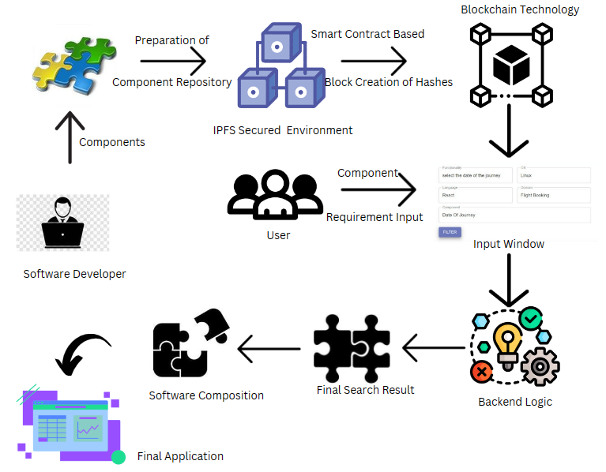
User Interface and Operation Steps

Slide 13
If the user wants to access the components then the following steps are required.
Step 1: The user need to do Signup if they have not been a member of this Open Source repository i.e. new user.
Fig 1.1 SignUp page

Slide 14
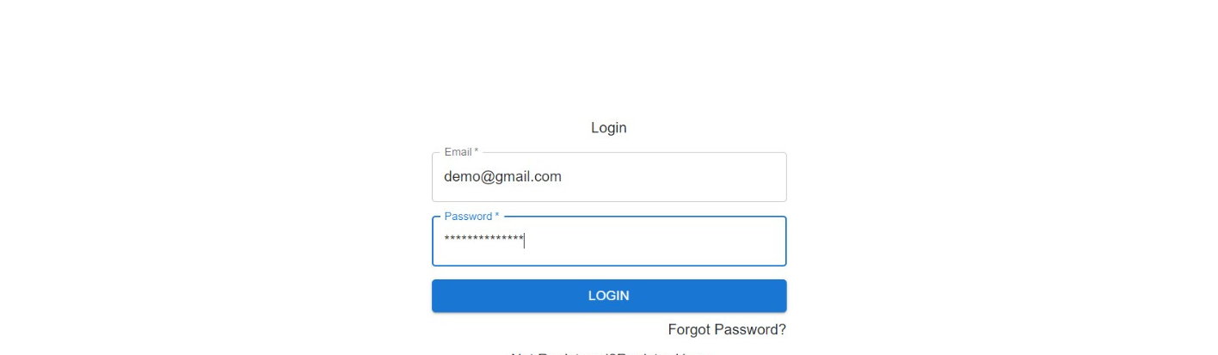
If the user is already a member of this Open Source repository then they simply need to login.
Fig 1.2 Developer login page

Slide 15
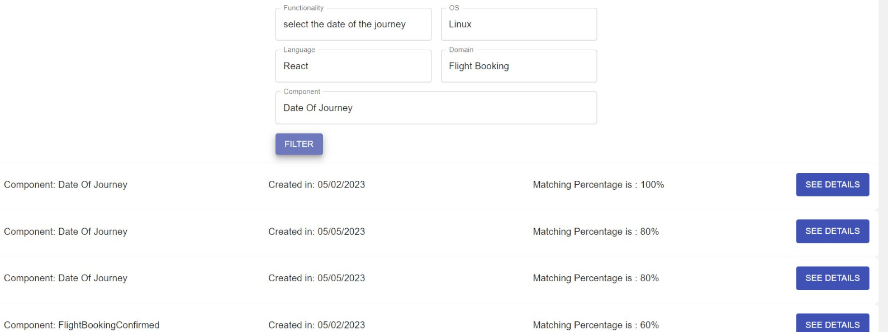
Step 2: If the Login is successful then users will be welcomed with ‘Main GUI’ where they can fill in the requirements like- Components name, OS name, and Framework.
Fig 1.3 Project GUI showing the matching percentage of requests

Slide 16
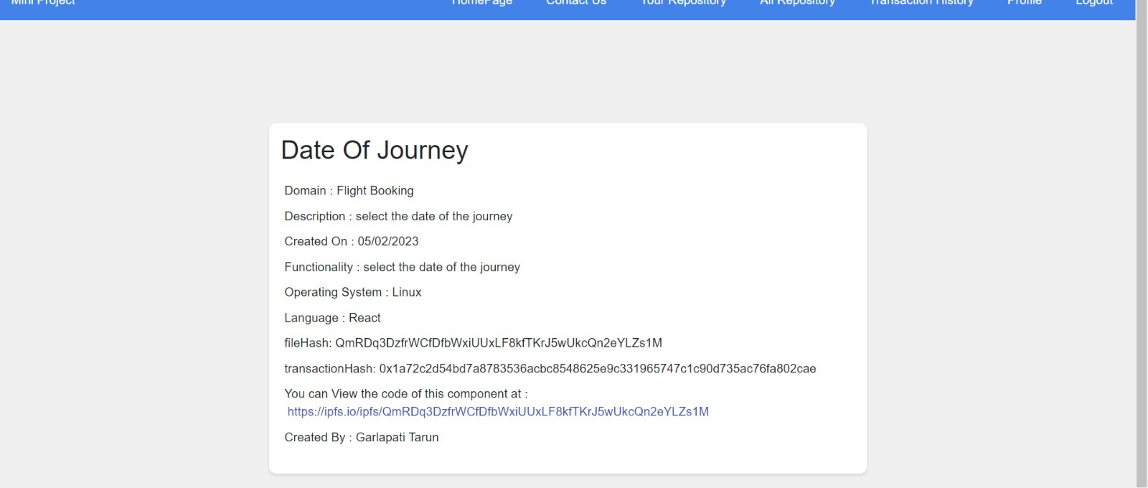
Step 3: According to the user request, the Repository System matches the percentage of requests and gives the details of matched components.

Slide 17
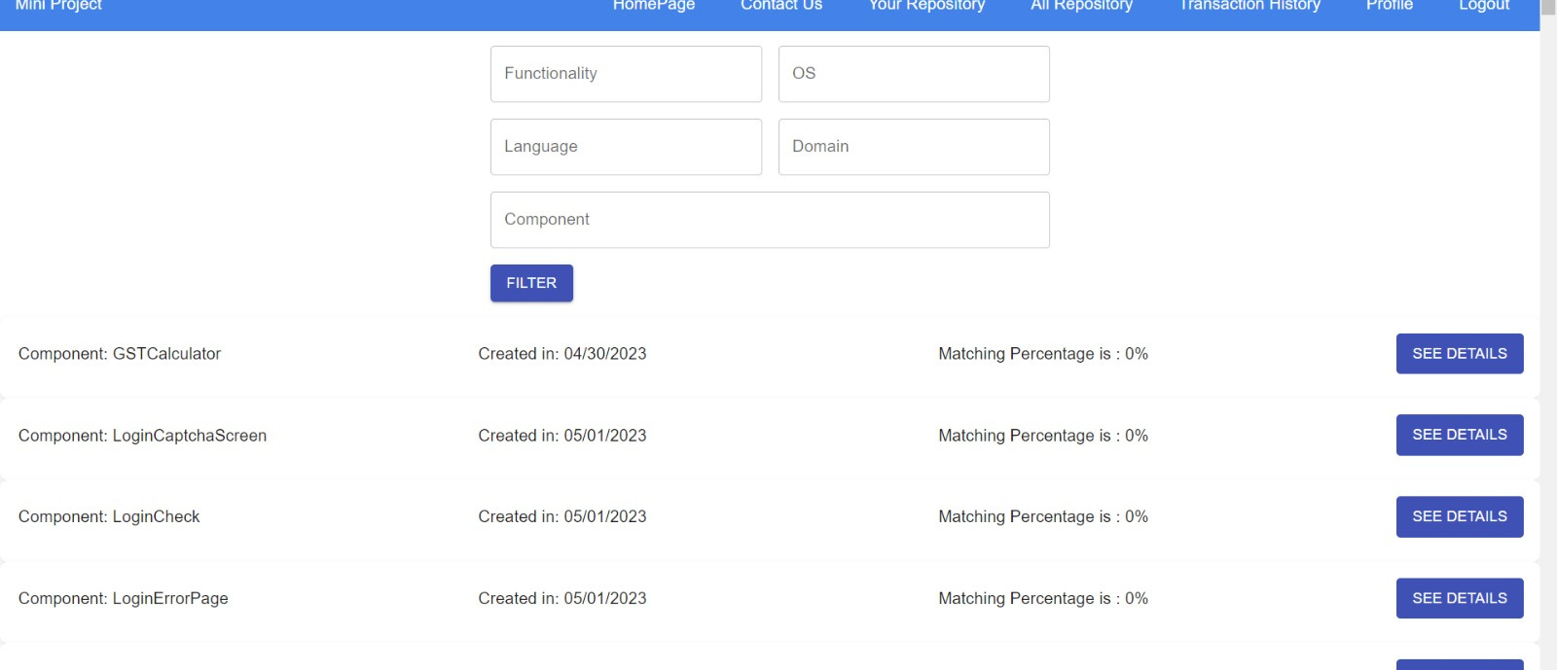
Fig 1.4 Result according to the request

Slide 18
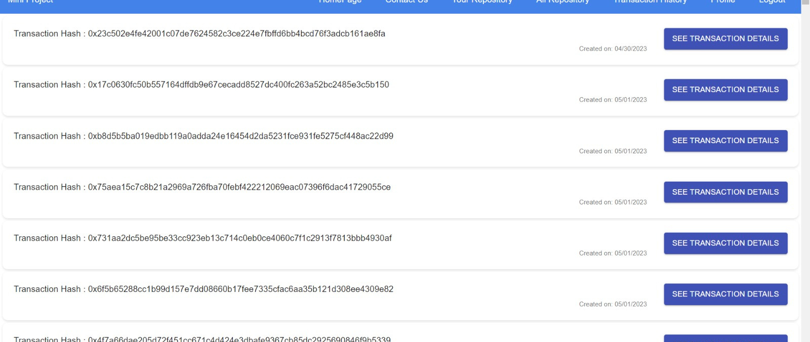
Note: Users can easily monitor components stored on the IPFS network and their hash is secure via blockchain by pushing on the blockchain network.
Fig 1.5 Transaction hash of components

Slide 19
Conclusion
In this project, we utilized blockchain and IPFS technology to mitigate software supply chain attacks by securing the use of third-party components in an untrusted environment. We conducted a thorough study of various software supply chain attacks and the workings of different tools and technologies. Our model significantly reduces the risk of such attacks, allowing developers to create secure software with third-party components.

Slide 20
Future Work
01 | Before uploading the component code in the application, we will check whether it has a malicious code or not.
02 | Before uploading the component code in the application, we will check that the components of the same name do not already exit [8].
03 | Enable users to earn rewards for contributing to the platform

Slide 21
01 | Greenberg, Andy. "The untold story of NotPetya, the most devastating cyberattack in history." Wired, August 22 (2018).
02 | Martin, Robert Alan. "Visibility & control: addressing supply chain challenges to trustworthy software-enabled things." 2020 IEEE Systems Security Symposium (SSS). IEEE, 2020.
03 | Porru, Simone, et al. "Blockchain-oriented software engineering: challenges and new directions." 2017 IEEE/ACM 39th International Conference on Software Engineering Companion (ICSE-C). IEEE, 2017.
04 | Della Valle, Fabio, and Miquel Oliver. "Blockchain enablers for supply chains: How to boost implementation in industry." IEEE access 8 (2020): 209699-209716.
05 | Marjanović, Jelena, Nikola Dalčeković, and Goran Sladić. "Improving critical infrastructure protection by enhancing software acquisition process through blockchain." 7th Conference on the Engineering of Computer Based Systems. 2021.
06 | You can also record a video inside the editor! Go to 'Uploads' and click on 'Record yourself'.
References

Slide 22
06 | Malik, Sidra, et al. "Trustchain: Trust management in blockchain and iot supported supply chains." 2019 IEEE International Conference on Blockchain (Blockchain). IEEE, 2019
07 | Giedrimas, Vaidas. "The role of blockchain for increase trust on software components and services." 2020 IEEE 14th International Conference on Application of Information and Communication Technologies (AICT). IEEE, 2020
08 | Ohm, Marc, et al. "Backstabber’s knife collection: A review of open source software supply chain attacks." Detection of Intrusions and Malware, and Vulnerability Assessment: 17th International Conference, DIMVA 2020, Lisbon, Portugal, June 24–26, 2020, Proceedings 17. Springer International Publishing, 2020. APA
References

Slide 23
Thank You
Presented by
Team leader : Anuj kesarwani 20208022
Member : Harshit chaudhari 20208054
Member : Jitendra kumar 20208060
Member : G.arlapati Tarun 20208047

